Slide 1
Mortality trends due to Respiratory diseases in Americas
Anurag Sneh, Manshi Shah
Notes:
USA, Cuba, Puerto Rico, Uruguay, Argentina are the top five mortality per capita countries as of year 2015-2018.

Slide 2
Respiratory diseases
Are pathological conditions affecting the lungs and other parts of the respiratory system. These diseases range from mild to life threatening diseases such as common cold, asthma, bacterial pneumonia, pulmonary embolism, and lung cancer
Respiratory diseases can be classified in many ways like obstructive lung disease(asthma, chronic bronchitis, COPD), restrictive lung diseases, chronic respiratory diseases(CRD), respiratory tract infections, Tumors(lung cancer), pleural cavity diseases, pulmonary vascular diseases(pulmonary embolism), and neonatal diseases
The ICD codes of all the respiratory diseases is shown

Slide 3
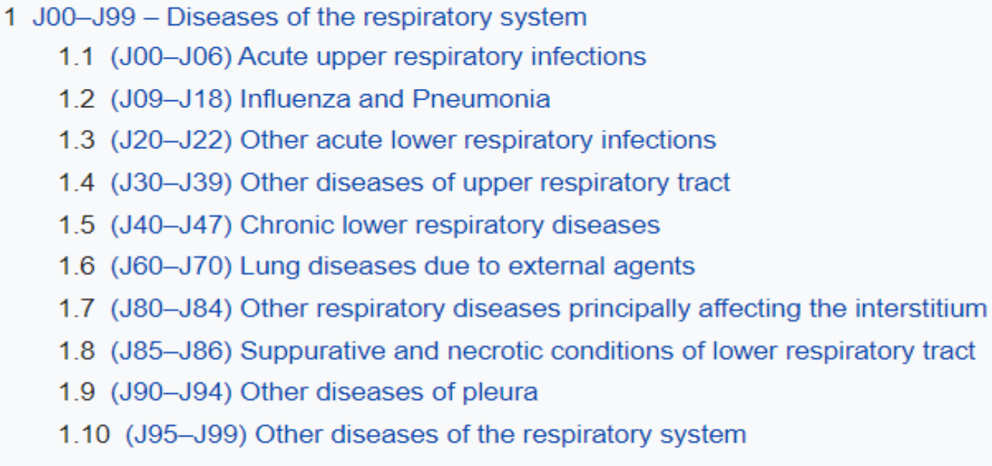
ICD10 categories of the respiratory diseases
Notes:
Respiratory diseases also include Lung Cancer but we haven’t included the same for our analysis.

Slide 4
Datasets used for analysis
Extraction of dataset for respiratory diseases
Mortality Data Set attached in Moodle
Population Dataset
https://data.worldbank.org/
GDP dataset
https://data.worldbank.org/indicator/NY.GDP.MKTP.CD
HDI dataset
http://hdr.undp.org/en/data#
State Wise Analysis Dataset
http://ghdx.healthdata.org/

Slide 5
Overview of research analysis
Mortality per capita in Americas due to respiratory diseases and their rise
Identifying the most/least dangerous respiratory diseases
Age groups and gender affected by the respiratory diseases
The relationship between HDI and MPC of a country with a rise in respiratory diseases
Population being the cause for MPC related to respiratory diseases
The relationship between GDP and MPC of a country with a rise in respiratory diseases
State wise analysis of respiratory diseases in USA

Slide 6
Mortality per capita in Americas due to respiratory diseases
Based on the analysis, respiratory diseases and their rise is shown in the top five mortality per capita countries during the years 2015- 2018 which are USA, Cuba, Puerto Rico, Uruguay and Argentina
Out of the five countries Argentina has the highest breakout in respiratory diseases

Slide 7
Identifying the most dangerous respiratory diseases
USA | Cuba | Puerto Rico | Uruguay | Argentina
J449(Chronic obstructive pulmonary disease) | J159(Bacterial Pneumonia) | J449(Chronic obstructive pulmonary disease) | J449(Chronic obstructive pulmonary disease) | J449(Chronic obstructive pulmonary disease)
J189(Pneumonia) | J440(Pulmonary disease with respiratory infection) | J189(Pneumonia) | J189(Pneumonia) | J189(Pneumonia)
J690(Pneumonitis due to inhalation of food and vomiting) | J182(Hypostatic pneumonia) | J690(Pneumonitis due to inhalation of food and vomiting) | J690(Pneumonitis due to inhalation of food and vomiting) | J969(Respiratory failure)

Slide 8
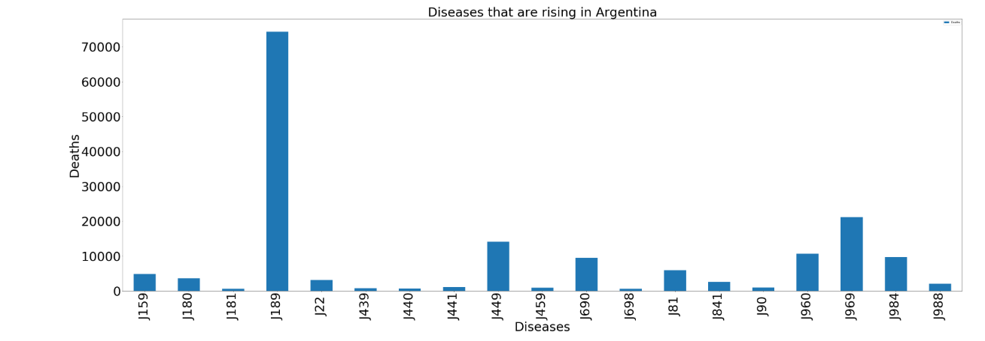
It is observed that Pneumonia is the most common disease among the five countries
Argentina is the most affected with Pneumonia

Slide 9
Gender affected by the respiratory diseases
Upon further analysis we found that overall male death count is higher than the female death count. However, the same isn’t true for J189, J182:
ICD10 | Number of deaths in from 2015 - 2018
J449(Chronic obstructive pulmonary disease) | 1626853 male deaths [Male > Female]
J189(Pneumonia) | 1348091 female deaths [Male < Female]
J690(Pneumonitis due to inhalation of food and vomiting) | 266336 male deaths [Male > Female]
J182(Hypostatic pneumonia) | 19569 female deaths [Male < Female]
J159(Bacterial Pneumonia) | 125402 male deaths [Male > Female]
Notes:
Pneumonia:
However, the US National Institute of Medical Science shows that women are less prone to have pneumonia. Also, if they suffer from it, then their chances to survive are higher.
https://www.ncbi.nlm.nih.gov/pmc/articles/PMC4215537/ . This is contrary to the results obta

Slide 10
Age groups affected by the respiratory diseases
Upon further analysis we found that overall 85 - 89 age groups are the most affected due to respiratory diseases. However, the same doesn’t hold true for the below case :
ICD10 | Age groups most affected and cause
J449(Chronic obstructive pulmonary disease) | 80-84
J189(Pneumonia) | 85-89
J690(Pneumonitis due to inhalation of food and vomiting) | 85-89
J182(Hypostatic pneumonia) | 85-89
J159(Bacterial Pneumonia) | 85-89
Notes:
Our world data states that :
2.56 million people died from pneumonia in 2017. Almost a third of all victims were children younger than 5 years, it is the leading cause of death for children under 5 which is contrast from our above analysis.

Slide 11
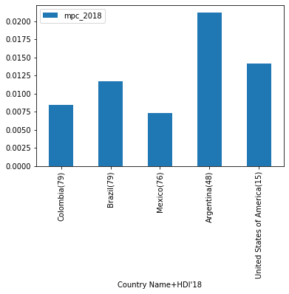
The relationship between HDI and MPC of a country with a rise in respiratory diseases
Notes:
– A long and healthy life – measured by life expectancy.
– Access to education – measured by expected years of schooling of children at school-entry age and mean years of schooling of the adult population.
– And a decent standard of living – measured by Gross National Income per capita adjusted for the price level of the country.

Slide 12
In the above visualization, the relationship between human development index and mpc measurement of the 5 countries that have the highest mortality per capita is determined
The observation shows that developing countries like Colombia, Brazil, Mexico have high HDI ranking but low mortality per capita, while USA and Argentina have low HDI and high mortality per capita
The visualization also shows that USA and Argentina have questionable public health systems and brings the urgency to reduce the mortality rate attributed to respiratory diseases, primarily pneumonia related diseases
Notes:
The Human Development Index (HDI) is a summary measure of average achievement in key dimensions of human development: a long and healthy life, being knowledgeable and have a decent standard of living. The HDI is the geometric mean of normalized indices for each of the three dimensions.
Very high HDI-[1-58]
High HDI-[60-112]
Medium HDI-[113-151]
Low HDI-[152-189]

Slide 13
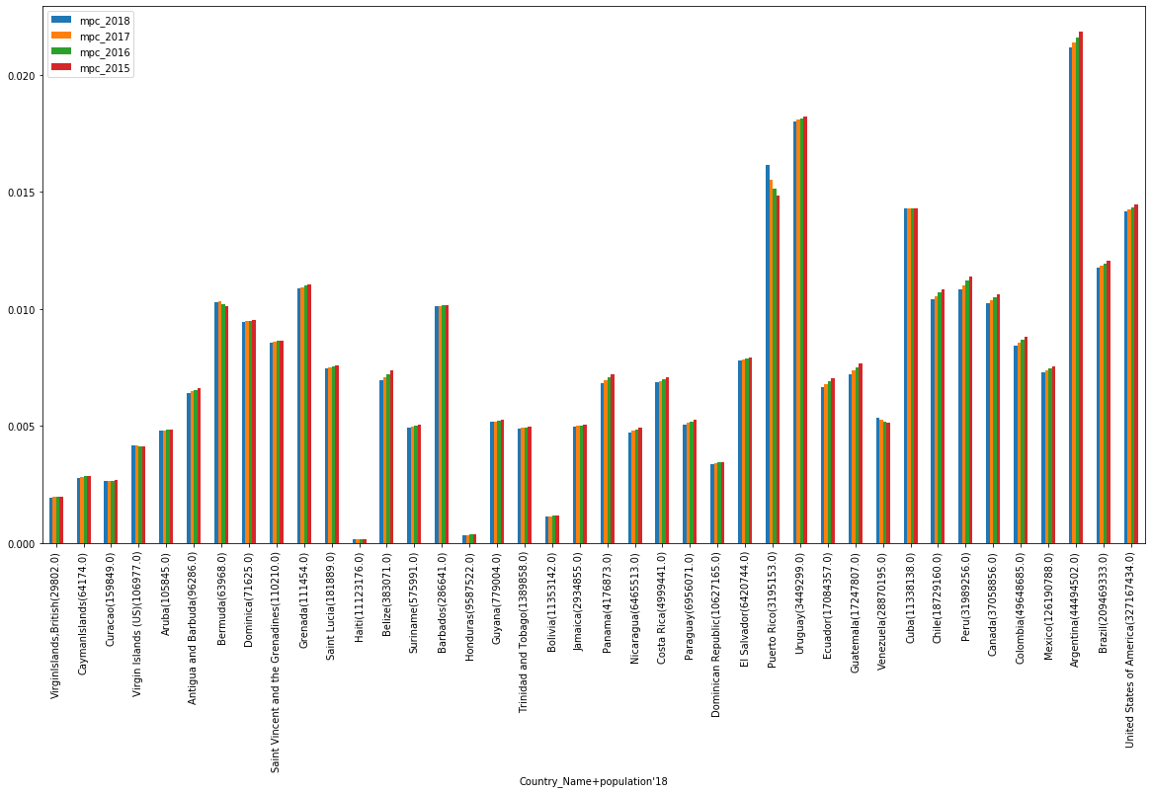
Relationship between Population and MPC related to respiratory diseases

Slide 14
Caution: Absolute death reported should not be considered a reliable parameter and overall public health should be ascertained by mortality per capita that takes population of a country into account.
The table is sorted by the death count in ascending order. As we go from left to right, the absolute death count increases. Though the death count in the USA is maximum, the mortality per capita is better than a lot of countries whose absolute death count figure is low
Puerto Rico’s population is about 1/10 th of that of USA but still mortality per capita is relatively poor. Thereby, we can conclude that population is not a chief parameter that contributes to the mortality per capita of a country. Besides population, other factors like HDI, GDP, Environmental conditions and lifestyle of the population are important predictors.

Slide 15
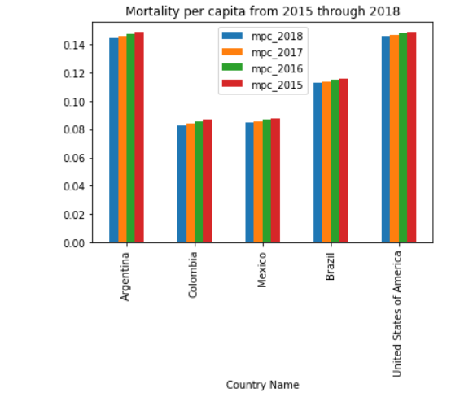
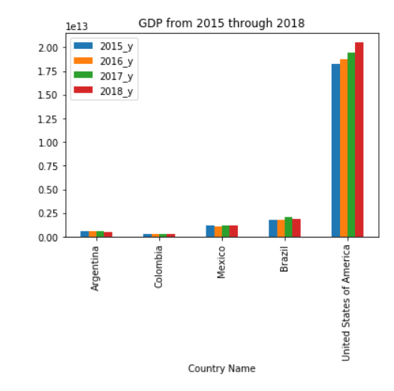
Relationship between GDP and MPC

Slide 16
It is a common notion that countries with high GDP have financial resources to combat diseases.
The visualisation shows us that a rich country like USA has poor mortality rate per capita figure, in comparison to countries like Colombia, Mexico and Brazil that have far less economic resources.
Brazil and USA have close MPCs despite their highly polarized GDPs.
Thus, we can say that GDP could be a partial contributing factor to MPC but not the sole prominent factor.

Slide 17
State wise Analysis in USA
We have taken into consideration all the 50 states and picked up all the counties that could serve as source of inspiration for maintaining a consistent record of lowest mortality rate due to respiratory diseases.
Following are the counties that could qualify to possess best respiratory health care. [Note that best is a very subjective terminology and different agencies have their own criterias of awarding this tag]
In our opinion, healthcare system that have steadfastly managed to keep the fatalities off respiratory diseases lowest throughout a significant span of 30 years without the slightest aberration.

Slide 18
Counties with lowest Mortality rate due to respiratory diseases
Makon County of Alabama Santa Cruz County of Arizona Pitkin County of Colorado Kent County of Delaware Ottawa County in Michigan Traverse County in Minnesota Rockingham County in New Hampshire Bergen County in New Jersey Mora County in New Mexico Biling County in North Dacota | Newport County in Rhode Island Beaufort County in North Carolina Cache county in Utah San juan County in Washington Tucker County in West Virginia Teton County in Woming
Notes:
It is interesting to note that besides New Jersey, New Hampshire and Washington none of the so called “rich states” have been able to showcase a model county level respiratory health system.
It’s time for these states to draw some inspiration from the other states that less richer.

Slide 19
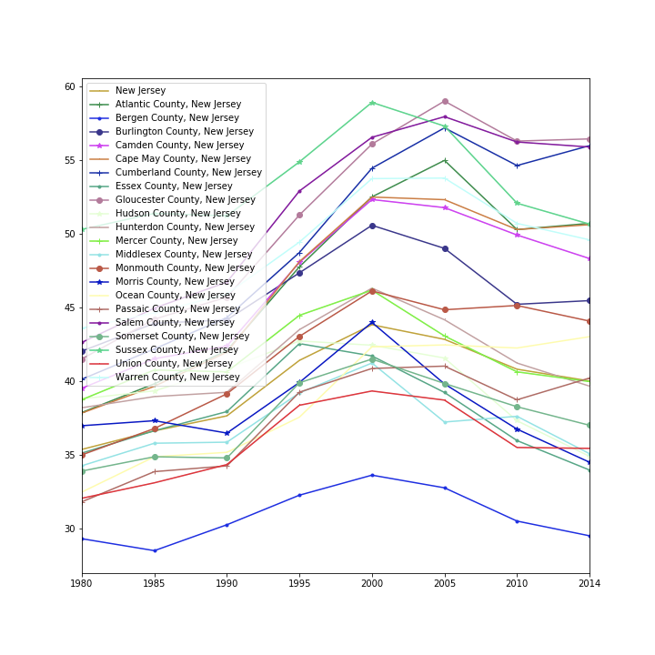
County wise depiction of the lowest mortality rate due to respiratory diseases.

Slide 20
THANK YOU !

